Slide 1

Advanced Security 2 Security Tools
C19704439 – Conor Farrell

Slide 2

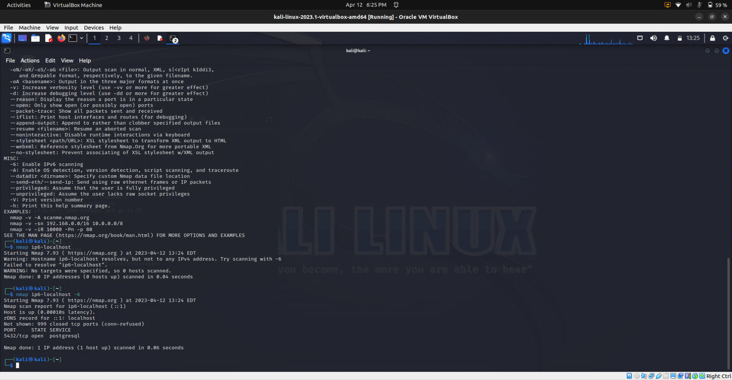
Kali Linux security tools - NMAP
Nmap is used to discover hosts and services on a computer network by sending packets and analysing the responses
Host discovery and service and operating system detection

Slide 3
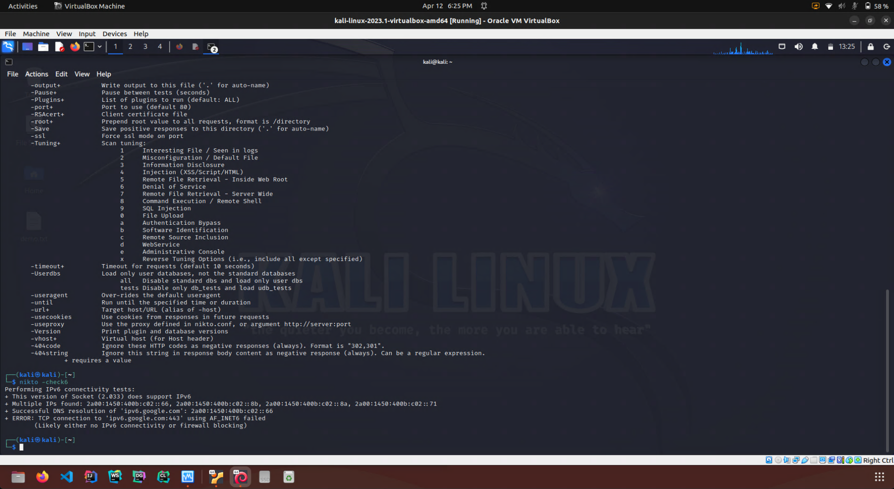
Kali Linux security tools - Nikto
Nikto is well suited for scanning web server-related vulnerabilities for small and medium enterprises
Scans webservers for dangerous files/CGIs, outdated server software and other problems

Slide 4
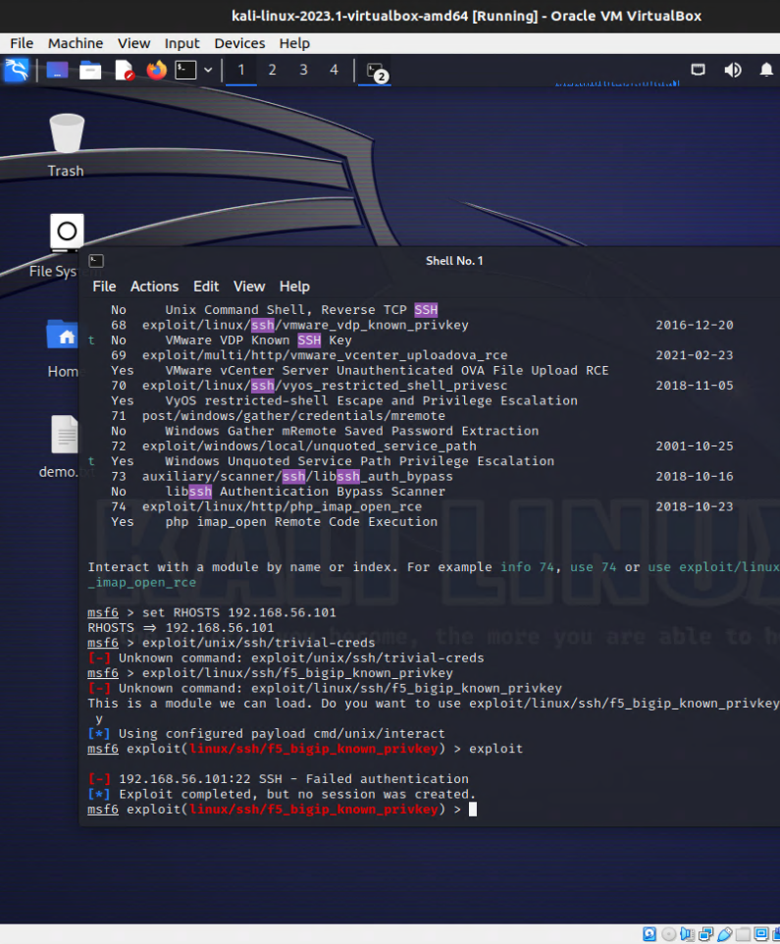
MetaSploit
This Ruby-based open-source framework allows testing via command line alterations or GUI
Use ready-made or custom code and introduce it into a network to probe for weak spots

Slide 5
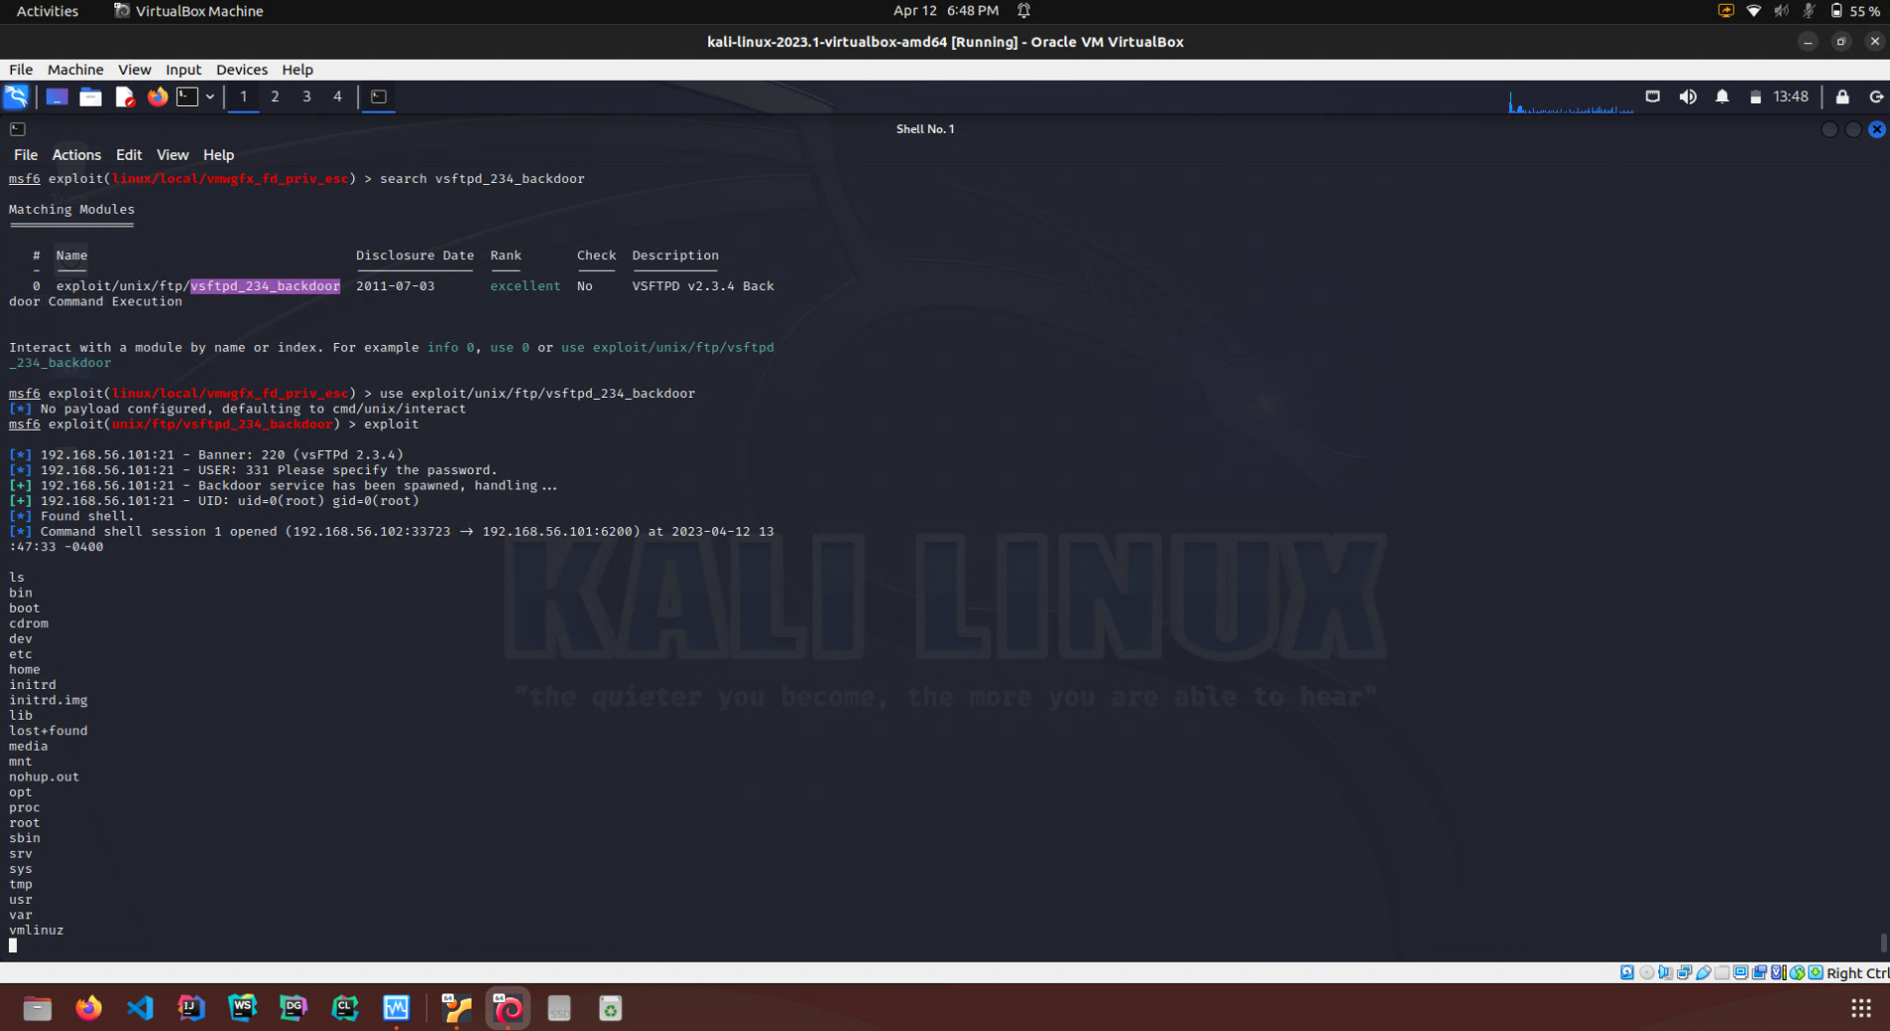
MetaSploit - Backdoor Access
Shown here is a VM that has access to another VM through Metasploit. It has root terminal access to the target machine.

Slide 6
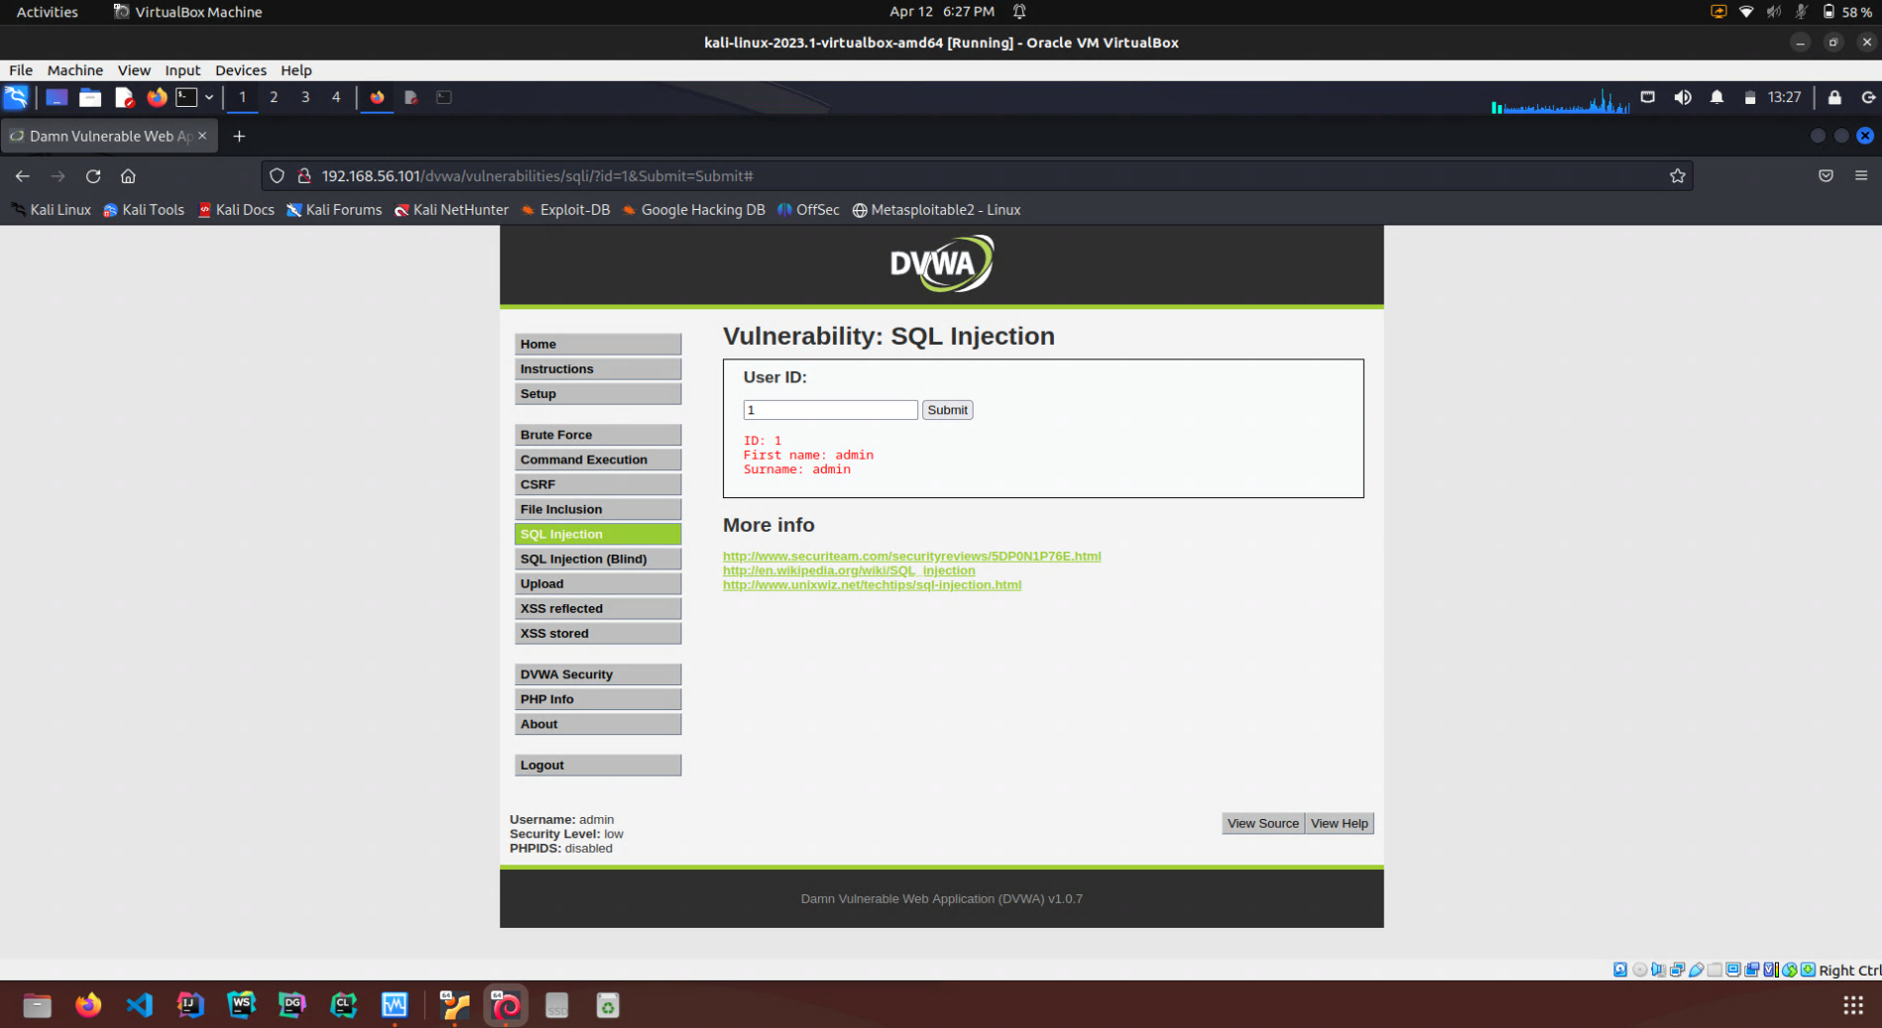
Damn Vulnerable Web Application (DVWA)
PHP/MySQL web application that is damn vulnerable
Goal is to be an aid for security professionals to test their skills and tools in a legal environment
SQL injection is a code injection technique used to attack data-driven applications, in which malicious SQL statements are inserted into an entry field for execution

Slide 7
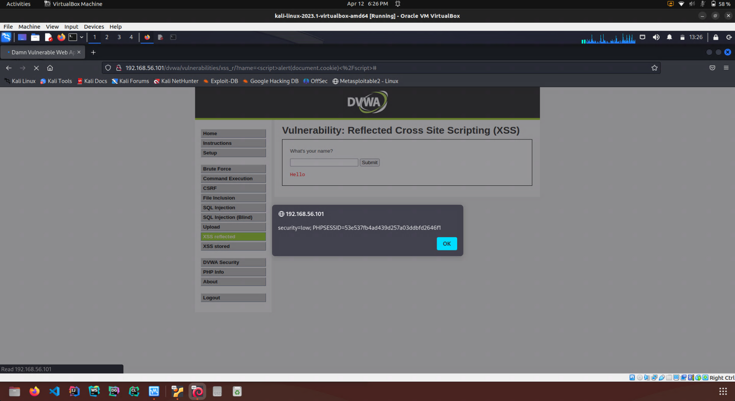
DVWA – XSS Reflected
Reflected cross-site scripting (or XSS) arises when an application receives data in an HTTP request and includes that data within the immediate response in an unsafe way
Can execute <script> tags directly in the browser to create the likes of pop-ups.

